Slide 1

CHAPTER 9
COUNTING AND PROBABILITY
Copyright © Cengage Learning. All rights reserved.

Slide 2

9.8
Probability Axioms and Expected Value
Copyright © Cengage Learning. All rights reserved.

Slide 3
Probability Axioms and Expected Value
Up to this point, we have calculated probabilities only for situations, such as tossing a fair coin or rolling a pair of balanced dice, where the outcomes in the sample space are all equally likely.
But coins are not always fair and dice are not always balanced.
How is it possible to calculate probabilities for these more general situations?

Slide 4
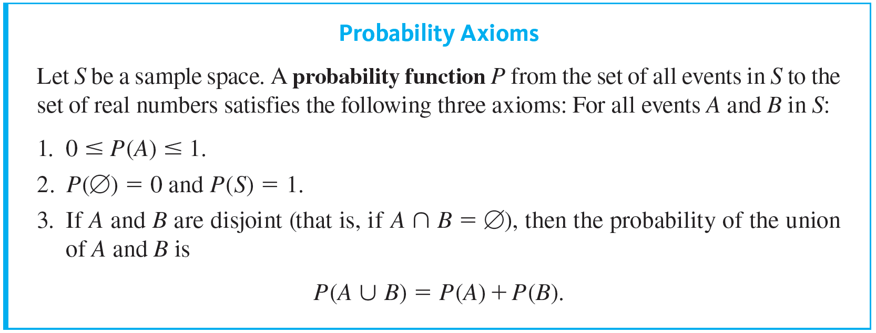
Probability Axioms and Expected Value
The following axioms were formulated by A. N. Kolmogorov in 1933 to provide a theoretical foundation for a far-ranging theory of probability.

Slide 5
Probability Axioms and Expected Value
In this section we state the axioms, derive a few consequences, and introduce the notion of expected value.
Recall that a sample space is a set of all outcomes of a random process or experiment and that an event is a subset of a sample space.

Slide 6
Example 9.8.1 – Applying the Probability Axioms
Suppose that A and B are events in a sample space S. If A and B are disjoint, could P(A) = 0.6 and P(B) = 0.8?

Slide 7
Example 9.8.1 – Solution
No. Probability axiom 3 would imply that P(A ∪ B) = P(A) + P(B) = 0.6 + 0.8 = 1.4, and since 1.4 > 1, this result would violate probability axiom 1.

Slide 8

Example 9.8.2 – The Probability of the Complement of an Event
Suppose that A is an event in a sample space S. Deduce that

Slide 9



Example 9.8.2 – Solution
S representing the universal set U,
and so
Thus S is the disjoint union of A and
and subtracting P(A) from both sides gives the result that

Slide 10
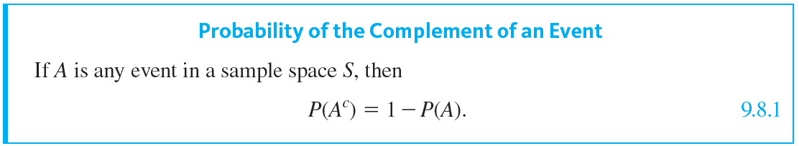
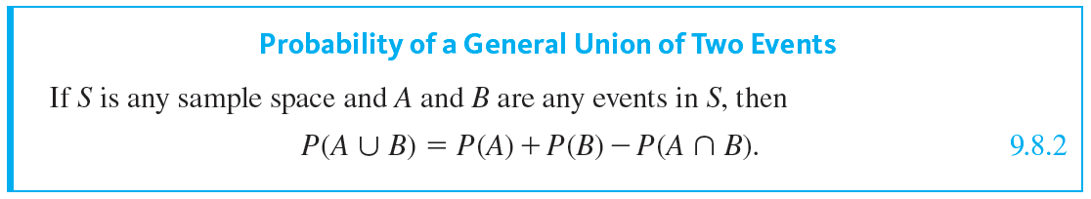
Probability Axioms and Expected Value

Slide 11
Example 9.8.4 – Computing the Probability of a General Union of Two Events
Suppose a card is chosen at random from an ordinary 52-card deck. What is the probability that the card is a face card (jack, queen, or king) or is from one of the red suits (hearts or diamonds)?

Slide 12
Example 9.8.4 – Solution
Let A be the event that the chosen card is a face card, and let B be the event that the chosen card is from one of the red suits. The event that the card is a face card or is from one of the red suits is A ∪ B.
Now N(A) = 4 · 3 = 12 (because each of the four suits has three face cards), and so P(A) = 12 ∕ 52.
Also N(B) = 26 (because half the cards are red), and so P(B) = 26 ∕ 52.

Slide 13
Example 9.8.4 – Solution
continued
Finally, N(A ∩ B) = 6 (because there are three face cards in hearts and another three in diamonds), and so P(A ∩ B) = 6 ∕ 52. It follows from the formula for the probability of a union of any two events that
Thus the probability that the chosen card is a face card or is from one of the red suits is approximately 61.5%.

Slide 14
Expected Value

Slide 15
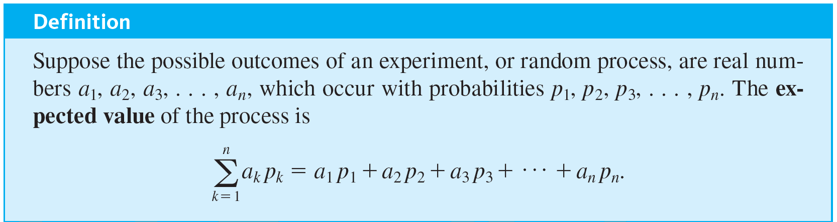
Expected Value

Slide 16
Example 9.8.5 – Expected Value of a Lottery
Suppose that 500,000 people pay $5 each to play a lottery game with the following prizes: one grand prize of $1,000,000, 10 second prizes of $1,000 each, 1,000 third prizes of $500 each, and 10,000 fourth prizes of $10 each.
What is the expected value of a ticket?

Slide 17

Example 9.8.5 – Solution
Each of the 500,000 lottery tickets has the same chance as any other of containing a winning lottery number, and so
for each k = 1, 2, 3, . . . , 500,000. Let a _{i} be the net gain for an individual ticket a _{i}, where a₁ = 999,995 (the net gain for the grand-prize ticket, which is one million dollars minus the $5 cost of the winning ticket), a₂ = a₃ = … = a₁₁ = 995 (the net gain for each of the 10 second-prize tickets), a₁₂ = a₁₃ = … = a_{1,011} = 495 (the net gain for each of the 1,000 third-prize tickets), and a_{1,012} = a_{1,013} = … = a_{11,011} = 5 (the net gain for each of the 10,000 fourth-prize tickets).

Slide 18
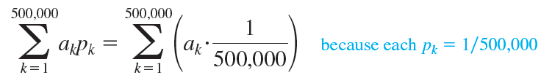

Example 9.8.5 – Solution
continued
Since the remaining 488,989 tickets just lose $5, a_{11,012} = a_{11,013} = … = a_{500,000} = −5. The expected value of a ticket is therefore
by theorem 5.1.1(2)

Slide 19
Example 9.8.5 – Solution
continued
= −1.78.
In other words, a person who continues to play this lottery for a very long time will probably win some money occasionally but on average will lose $1.78 per ticket.

